Slide 1
How to bake my web research
Yevhen Krupin
Tobii Pro Desktop R&D, Kyiv
1

Slide 2
Intro
Short introduction to “Tobii Pro Lab” and Web Stimuli

Slide 3
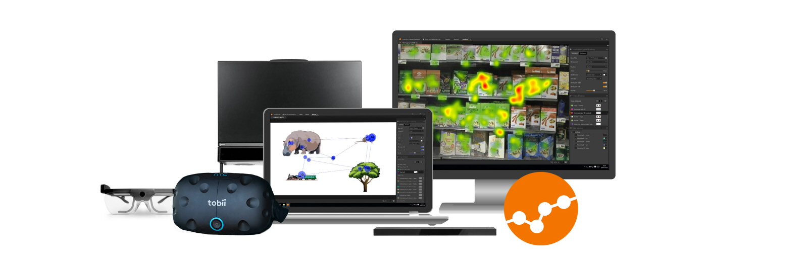
Tobii Pro Lab
Eye tracking software designed for conducting experimental research with Tobii Pro hardware
Source: Tobiipro.com

Slide 4
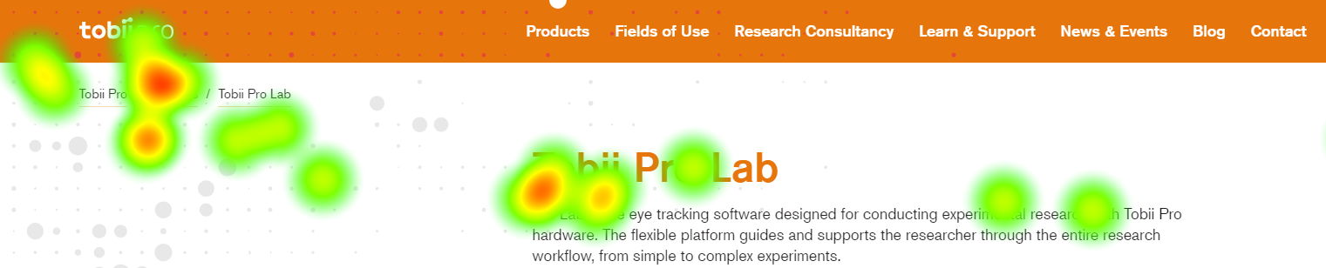
Web Stimuli
Let participant to easily surf between web pages
Conduct UX research inside of embedded Chromium based browser
Analyze gaze patterns with powerful analysis toolset

Slide 5
Embedded Browser
Why did we choose CEFSharp?
CEFSharp – C#/C++ wrapper of native CEF (Chromium embedded framework)
PROS
Lifecycle and version control
Execute JS and V8 Extensions
Inter-process communication
Headless/offscreen mode
Low level hooks/events
Could be topmost
Rendering as in Chrome
It is open sourced
CONS
Size (~100mb)
No flash support ☹
No MP4/MP3 support by default

Slide 6

Concepts
Tobii Pro Lab definitions
Event types and events
TOI and intervals
AOI and visits
Web/UX research definitions
Page
Fixes/sticky elements
Viewport
Read more

Slide 7
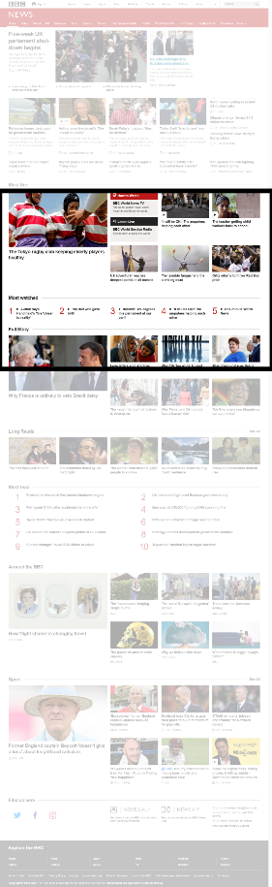
Concepts
Viewport
Viewport
Full page size

Slide 8
Concepts
Difference between event types and events
Events (instances)
Click
Open the page (Google.com)
Click
Click
Close the page (Google.com)
Open the page (Tobii.com)
Click
Close the page (Tobii.com)
Stop the recording
Event types (sets)
Clicks
Open the page (Google.com)
Close the page (Google.com)
Open the page (Tobii.com)
Close the page (Tobii.com)
Stop the recording

Slide 9
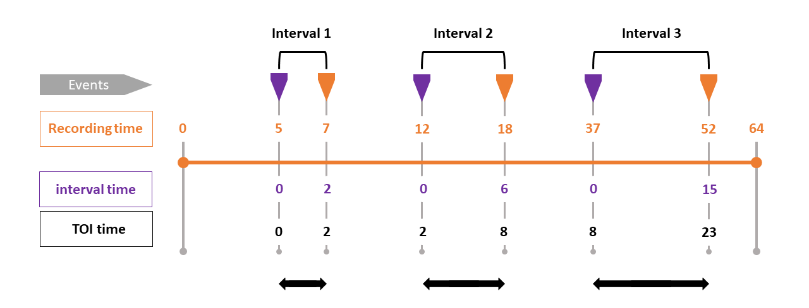
Concepts
Difference between Time of Interest and Interval
Source: Tobiipro.com

Slide 10
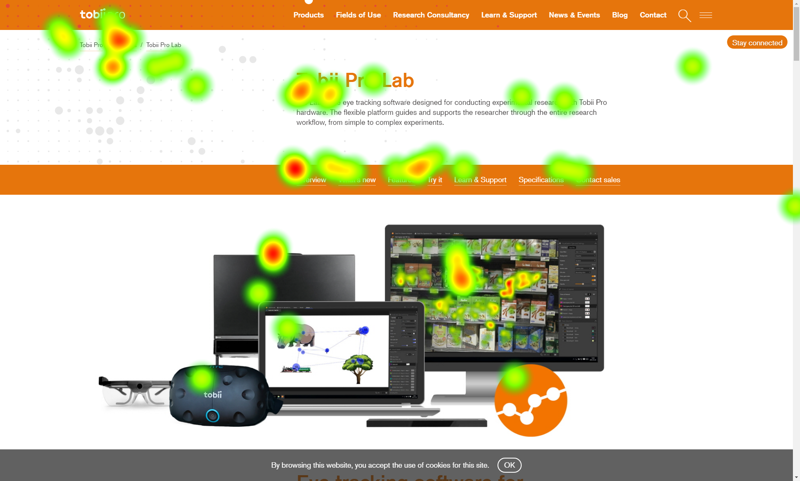
Visualizations

Slide 11
Metrics
Time to first fixation in the scope of TOI
Intervals count
Fixations count
Fixation duration
etc..

Slide 12
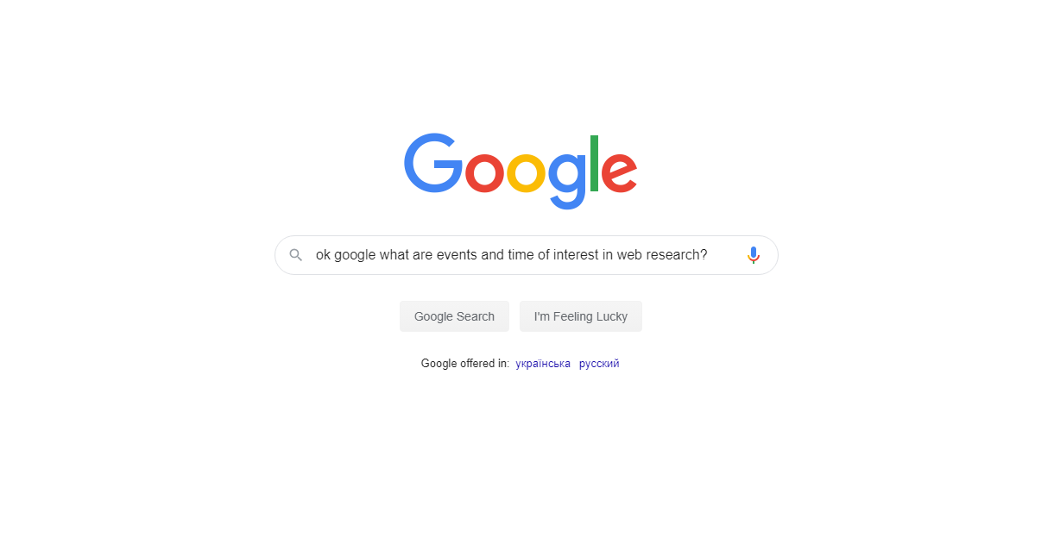

Slide 13
Web events
Navigation events
Other events
Address change
Title change
Page load start
Page load end
View port change
Mutation
Rendering event

Slide 14
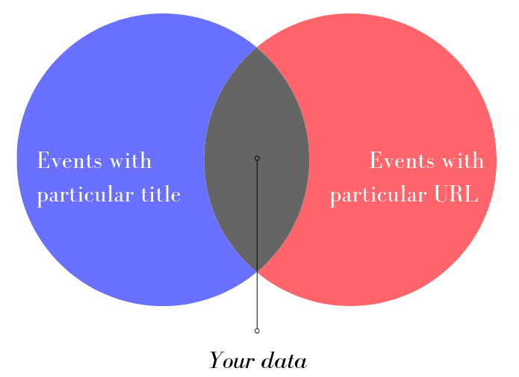
Web events

Slide 15
Web events
Type address
tobiipro.com
Async stuff
Some asynchronous requests
Page load
Document is loaded now
Resolve address
https://tobiipro.com
Page load starts
Page is visible
First render event
Title changes

Slide 16
Web events
Type address
tobiipro.com
Async stuff
Some asynchronous requests
Page load
Document is loaded now
Resolve address
https://tobiipro.com
Page load starts
Page is visible
First render event
Title changes
Type address
google.com

Slide 17
Web events
Type address
tobiipro.com
Async stuff
Some asynchronous requests
Page load
Document is loaded now
Resolve address
https://tobiipro.com
Type address
Page load starts
Page is visible
nytimes.com
First render event
Title changes
Type address
google.com

Slide 18
Web events
Still loading
Type address
tobiipro.com
Async stuff
Some asynchronous requests
Page load
Document is loaded now
Resolve address
https://tobiipro.com
Type address
Page load starts
Page is visible
nytimes.com
First render event
Title changes
Type address
google.com

Slide 19
Web events
Type address
tobiipro.com
Async stuff
Some asynchronous requests
Page load
Document is loaded now
Resolve address
Still loading
https://tobiipro.com
Type address
Page load starts
Page is visible
nytimes.com
First render event
Title changes
Type address
google.com

Slide 20
Web events
Type address
tobiipro.com
Async stuff
Some asynchronous requests
Page load
Document is loaded now
Resolve address
Jag är trött på att vänta
https://tobiipro.com
Type address
Page load starts
Page is visible
nytimes.com
First render event
Title changes
Type address
google.com

Slide 21
Web events
Type address
tobiipro.com
Async stuff
Some asynchronous requests
Page load
Document is loaded now
Resolve address
Still loading
https://tobiipro.com
Type address
Page load starts
Page is visible
nytimes.com
First render event
Title changes
Type address
Finally loaded
google.com

Slide 22
Web Navigation TOI
Different Event types and TOIs of different pages
Tobii Home Page
Title: Eye tracking technology for research - Tobii Pro
Address: https://www.tobiipro.com/
Home URLOpen Event Type | Home URLClose Event Type
Tobii Contact Page
Title: Contact us - Tobii Pro
Addess: https://www.tobiipro.com/contact/
Contact URLOpen Event Type | Contact URLClose Event Type

Slide 23
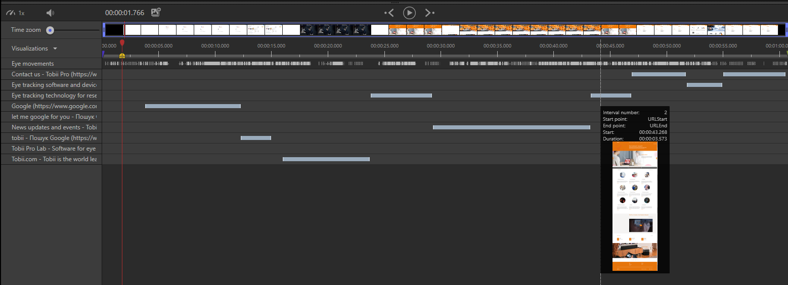
Web Navigation TOI
Visualization of TOI intervals in timeline

Slide 24
Naive TOI start
Type address
nytimes.com
Resolve address
https://nytimes.com
Page load
Start TOI
Page load starts
Page is visible
nytimes.com
First render event
Title changes

Slide 25
Naive TOI start
Type address
nytimes.com
Resolve address
https://nytimes.com
Page load
Start TOI
Page load starts
Page is visible
nytimes.com
First render event
Title changes
Gaze data is skipped

Slide 26
Naive TOI start
Time to first fixation cannot be calculated
First impression cannot be calculated
Gaze data is skipped for interval before page load
Fixation duration and fixation count lie
etc..

Slide 27

Web browser as media player
Highly interactive media player
You move mouse
Cursor hovers the button
CEF refreshes part of the screen
UI shows new image
Rendering
Up to 60 FPS
When frame appears it means user can see web page
Read more

Slide 28
Weighted approach
Type address
nytimes.com
Resolve address
https://nytimes.com
Page load
Page load starts
Page is visible
nytimes.com
First render event
Start TOI
Title changes
Inject scripts

Slide 29
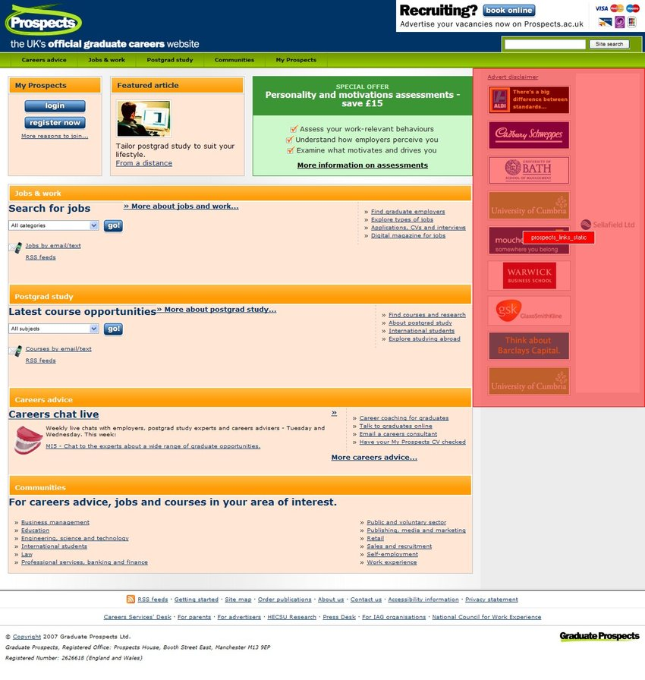
Concepts
TOI - When
AOI - Where
12
9
3
6
Page 1
Page 2
Page 1
Page 3
Source: Researchgate.com

Slide 30
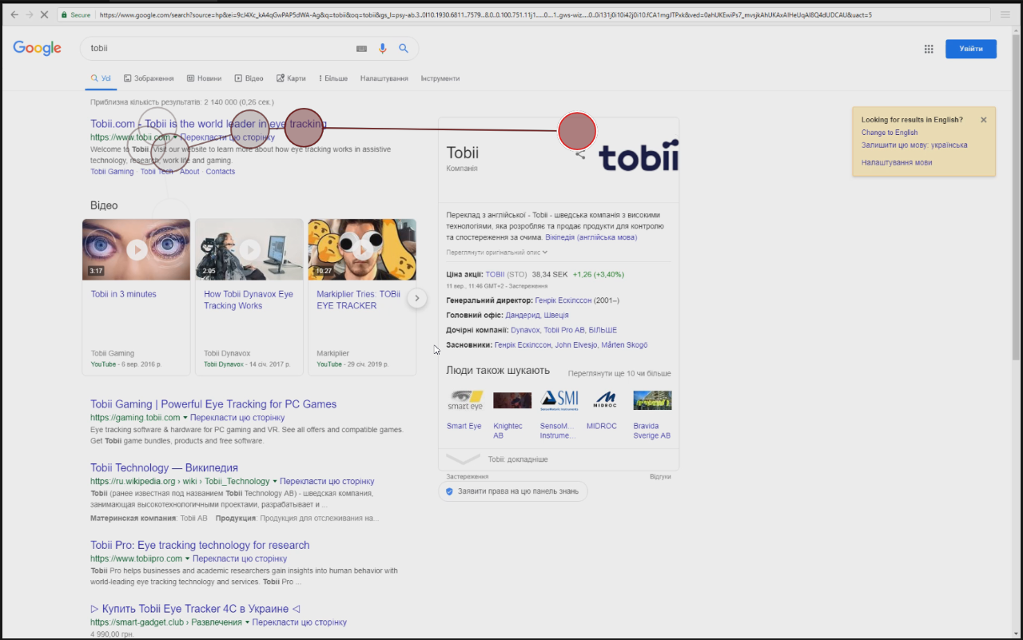
AOI should be drawn on media
Moving AOI on video
Static AOI on screenshot
Source: Researchgate.com, Canva

Slide 31
Take screenshot on page load
Type address
nytimes.com
Resolve address
https://nytimes.com
Page load
Page load starts
Page is visible
nytimes.com
Take screenshot
First render event
Start TOI
Title changes
Inject scripts

Slide 32
Take screenshot before leave the page
Type address
nytimes.com
Resolve address
https://nytimes.com
Page load
Try to leave the page
Page load starts
Page is visible
nytimes.com
First render event
Take screenshot
Start TOI
Title changes
Inject scripts

Slide 33
Screenshot making approaches
Approach | Pros | Cons
Headless | No UI/UX impact | Image could be different, sessions handling, needs other approaches
JS code | Ready open-source solution | Visible for user, image could look differently
Stitched | Limitless size, better fixed elements handling | Highest complexity, potentially different frames during animation, some UI/UX impact especially on huge pages
Chrome API | Easy API | Is not available in CEF ☹
Resize browser | Reliable, atomic | Complexity, duration, and several crucial issues, UI/UX impact

Slide 34
Screenshot making approaches
Approach | Pros | Cons
Headless | No UI/UX impact | Image could be different, sessions handling, needs other approaches
JS code | Ready open-source solution | Visible for user, image could look differently
Stitched | Limitless size, better fixed elements handling | Highest complexity, potentially different frames during animation, some UI/UX impact especially on huge pages
Chrome API | Easy API | Is not available in CEF ☹
Resize browser | Reliable, atomic | Complexity, duration, and several crucial issues, UI/UX impact

Slide 35
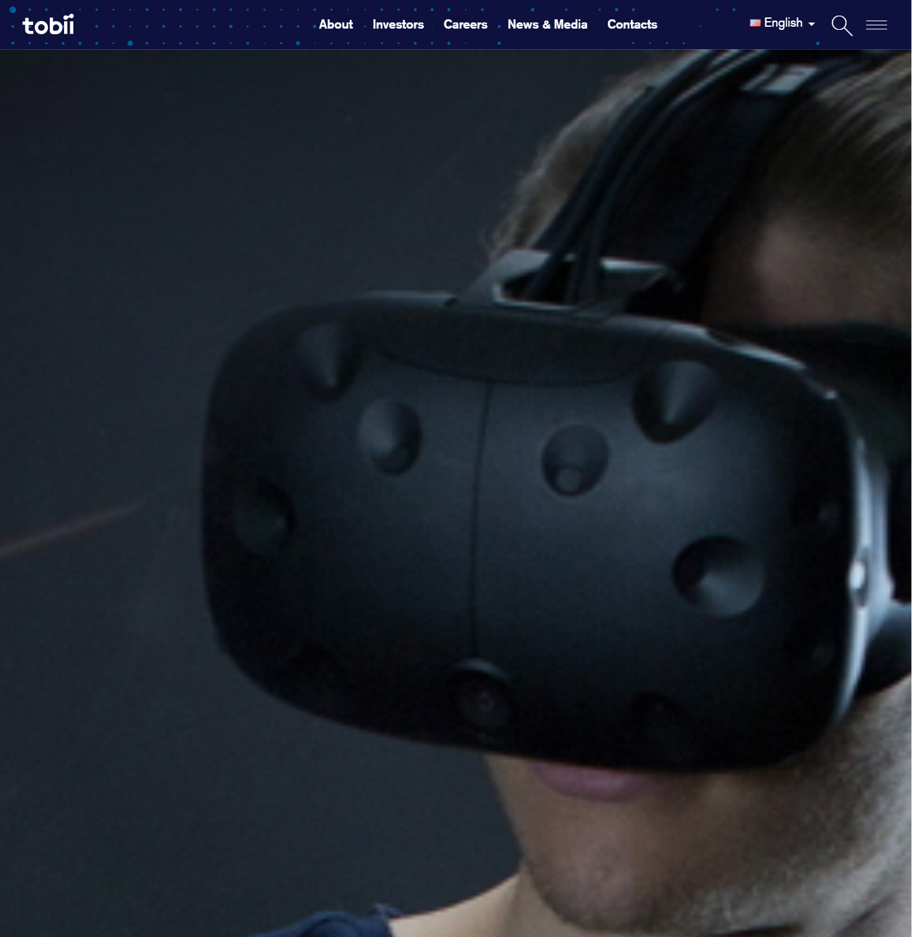
Pitfalls of browser resizing
Dom elements
Hero image
Fixed elements
Partial rendering of page
Lazy content not visible
UI/UX impact: blink
Deadlock with height > 15k px

Slide 36

Need to use Problem solving starter pack

Slide 37
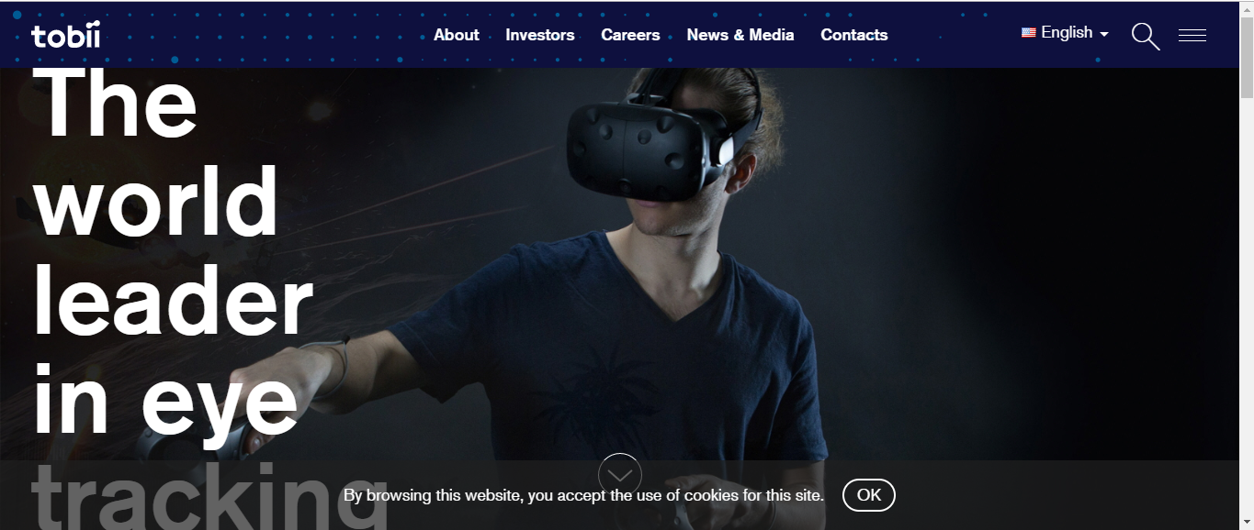
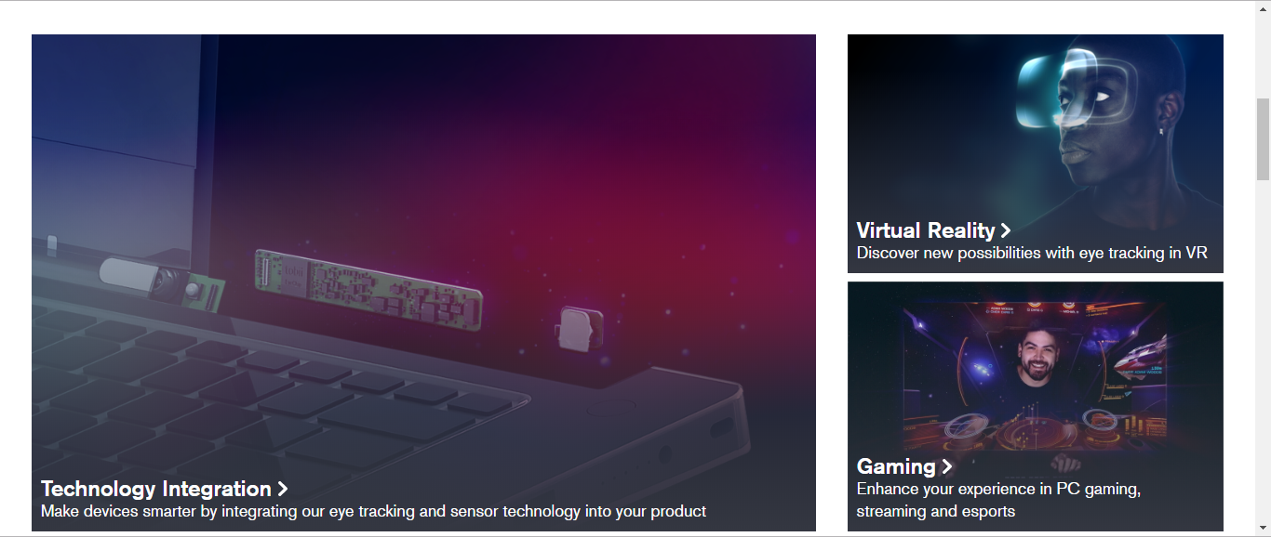

Hey Siri, let’s stitch some screenshot parts
Elements occupy correct sizes
So no hero images
Fixed elements appear in viewports
Size limited only by resources

Slide 38
Translate gaze data
We store all scroll events and could translate gaze data according to viewport offset.
Translated gaze data would be used to calculate metrics, to show the visualization etc.
Read more
38

Slide 39
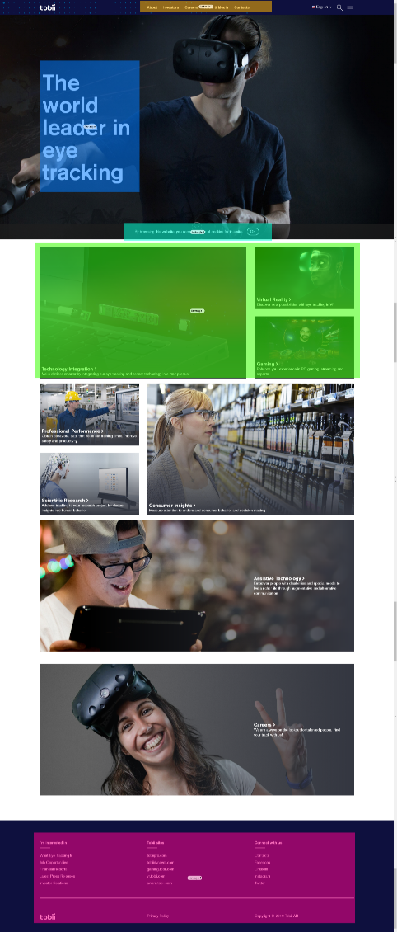
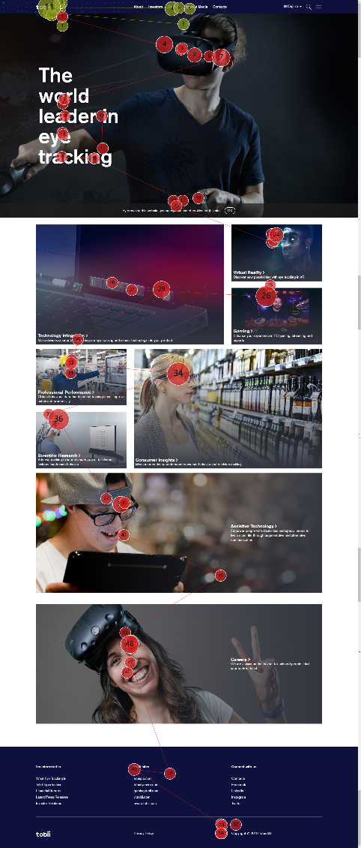
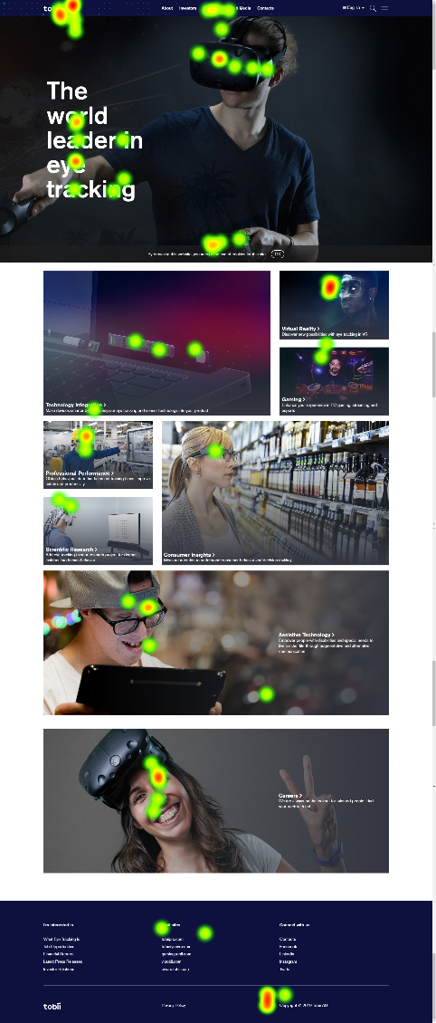
Applying of screenshot and gaze data

Slide 40
Challenges
Still struggling with
Viewport duplication in case of pages highly saturated by fixed elements
Dynamic fixed elements
Single page applications navigation – actual navigation does not occur
Custom Web TOI – currently in implementation
Other highly requested challenges: Clickpath, Dom Recorder and Auto AOIs, Tabs, Task based analysis.

Slide 41

Tack så mycket
This presentation on GitHub
41

Slide 42
Rich text - three columns (30p)
Subtitle (20p)
Subtitle bold (14p)
Subtitle bold (14p)
Subtitle bold (14p)
Body text (12 p)
Body text (12 p)
Body text (12 pt)

Slide 43
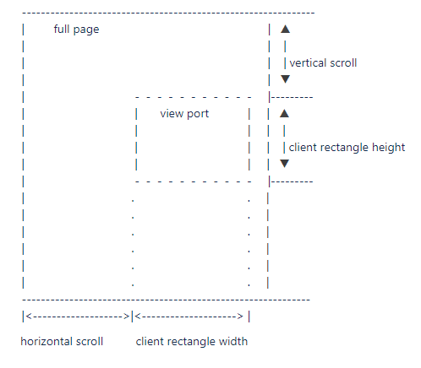
Concepts
Viewport

Slide 44
Rich text - three columns (30p)
Subtitle bold (14p)
Subtitle bold (14p)
Subtitle bold (14p)
Body text (12p)
Body text (12p)
Body text (12p)

Slide 48
Tobii Pro Title bold (36p)
Name (22p)
Title (16p)

Slide 49
How to bake my web research
Yevhen Krupin
Tobii Pro Desktop R&D, Kyiv

Slide 50
Intro
Short introduction to “Tobii Pro Lab” and Web Stimuli

Slide 51
Tobii Pro Title bold (36p)
Name (22p)
Title (16p)

Slide 52
Divider page bold (36p)
Subtitle describing content (22)

Slide 53
Title (30p)
Text (22p)
Second level (16p)
Third level (14p)
Shapes in light grey with dark blue thin border (¼ p)

Slide 54
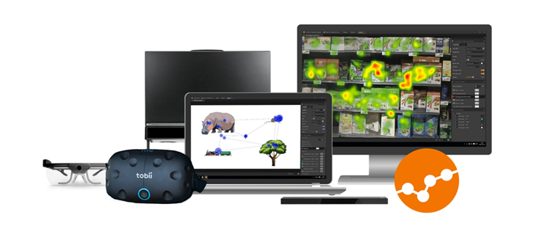
Tobii Pro Lab
Eye tracking software designed for
Conducting experimental research with Tobii Pro hardware
Provide powerful analytics and visualization
Integration with third-party devices and sensors

Slide 55
Colors Tobii Pro
Primary
Secondary
R 243
G 117
B 0
R 238
G 70
B 59
R 253
G 217
B 179
R 179
G 179
B 179
R 65
G 64
B 66
R 144
G 182
B 225
Hyperlink
R 134
G 185
B 255
R 77
G 83
B 215
Text object in dark grey (18p)

Slide 56
Terminology
(20p)
Tobii Pro Lab definitions
Event types and events
TOI and intervals
AOI and visits
Web/UX research definitions
Viewport
Page
Fixes/sticky elements
Read more

Slide 57
Terminology
(20p)
Text (22p)
Second level (16p)
Third level (14p)

Slide 58
Two pieces of content (30p)
Text (22p)
Second level (16p)
Text (22p)
Second level (16p)

Slide 59
Content and graph on right side (30p)
Text (22p)
Second level (16p)

Slide 60
Compare two columns (30p)
Subtitle bold (22p)
Subtitle bold (22p)
Text (22p)
Second level (16p)
Text (22p)
Second level (16p)

Slide 61
Rich text – two columns (30p)
Subtitle (20p)
Subtitle bold (18p)
Subtitle bold (18p)
Body text (14p)
Body text (14p)

Slide 62
Web events
Type address
tobiipro.com
Async stuff
Some asynchronous requests
Page load
Document is loaded now
Resolve address
Still loading
Jag är trött på att vänta…
https://tobiipro.com
Type address
Page load starts
Page is visible
nytimes.com
First render event
Title changes
Type address
Finally loaded
google.com

